Slide 1
Architecting backup solutions in a Hybrid Cloud World
James Kilby, Veeam Vanguard

Slide 2
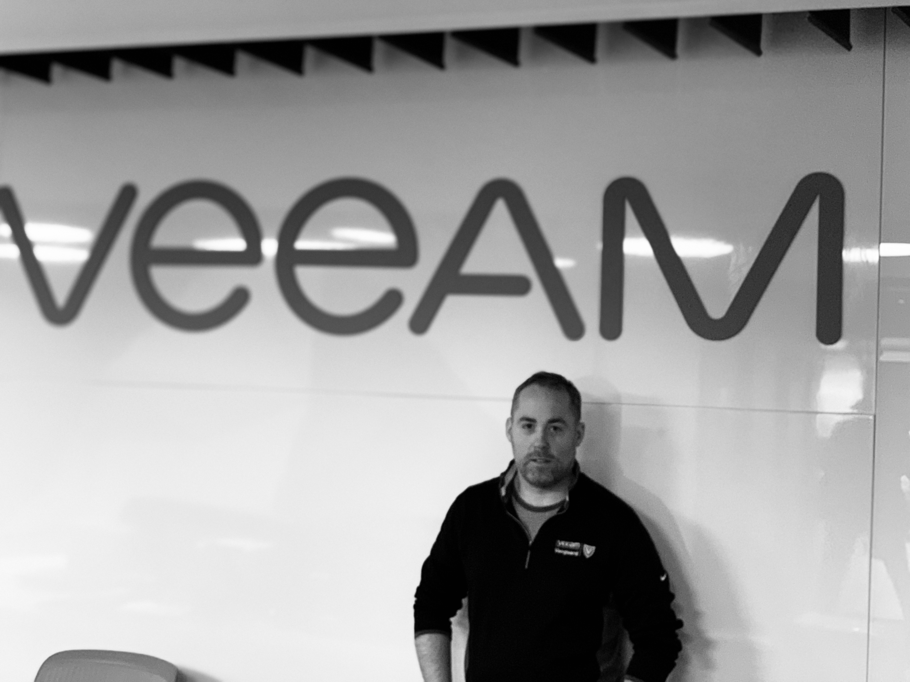
About Me:
Founding member of the Veeam UK Usergroup
Veeam Vanguard for 4 years
Veeam Certified Engineer 2020
AWS Solutions Architect
VMware Cloud on AWS Master Specialist
Notes:
Work for Xtravirt Vmware premier partner based in the UK

Slide 3
Presentation Overview
AWS 101
VMware Cloud on AWS – Intro & Overview
Design Principals
High Level Solution Overview
Design - Proxy
Design - Primary Backup Storage
Design - Secondary Backup Storage
Design - Network

Slide 4
AWS 101 – Basic Terms
AWS Term - Definition
Region – A group of geographically close availability zones
Availability Zone – One or more distinct datacentres
EC2 - AWS Virtual Machines
EBS – Elastic Block Storage
S3 – Amazon’s Object Storage
ENI – Elastic Network Interface
VPC – Virtual Private Cloud
VPC Endpoint – Private connection to supported AWS services

Slide 5
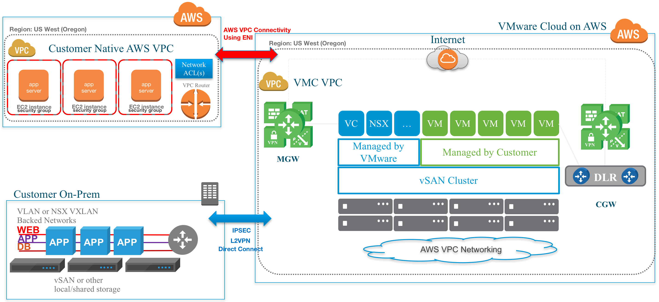
VMware Cloud on AWS Overview
Notes:
ENI – Describe
Customer /VMware account
Define
VPC
MGW CGW
Jointly engineered solution
Veeam was the first Backup vendor to be officially supported

Slide 6
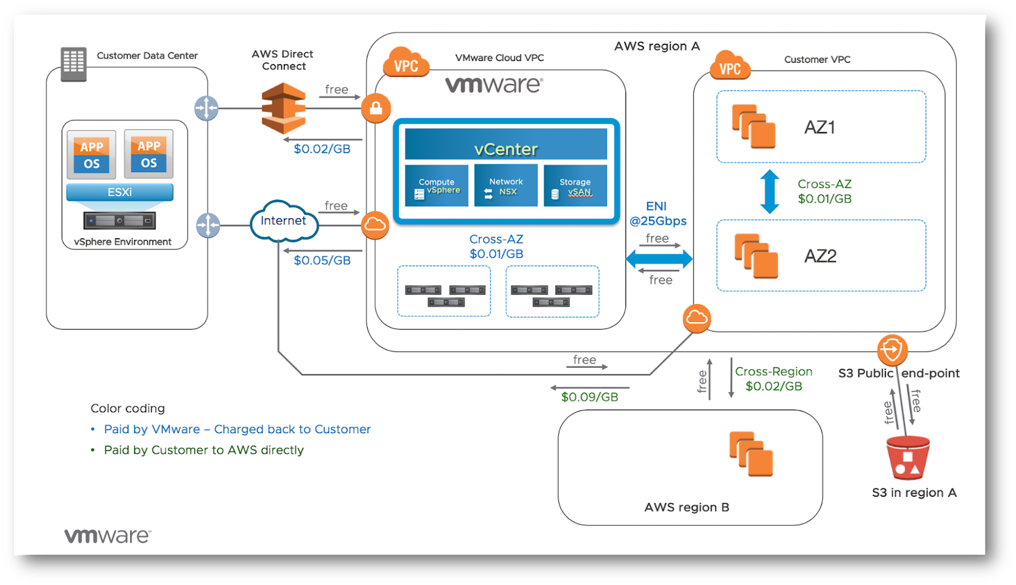
Network Costs

Slide 7
Design Principals
3-2-1 Rule must be followed
Optimize RPO – RTO
Minimize Cost where possible
Fast primary storage
Cheaper Longterm storage
Easily Scalable
Automate where possible
Notes:
Constraints around locations and licensing

Slide 8
Backup Storage Tiers
 | Primary* | Secondary | Archive
Cost per TB | High | Low | Lowest
Storage Capacity | Low | High | Unlimited
IOPS Capacity | High | Average | Low
Reliability | Standard | Low | Best
Restore Costs | Lowest | Average | Worst
*Primary storage tier should be sized to cover operational restores, Secondary if used should cover all restores
Notes:
Operational Restores typically 14-30 days

Slide 9
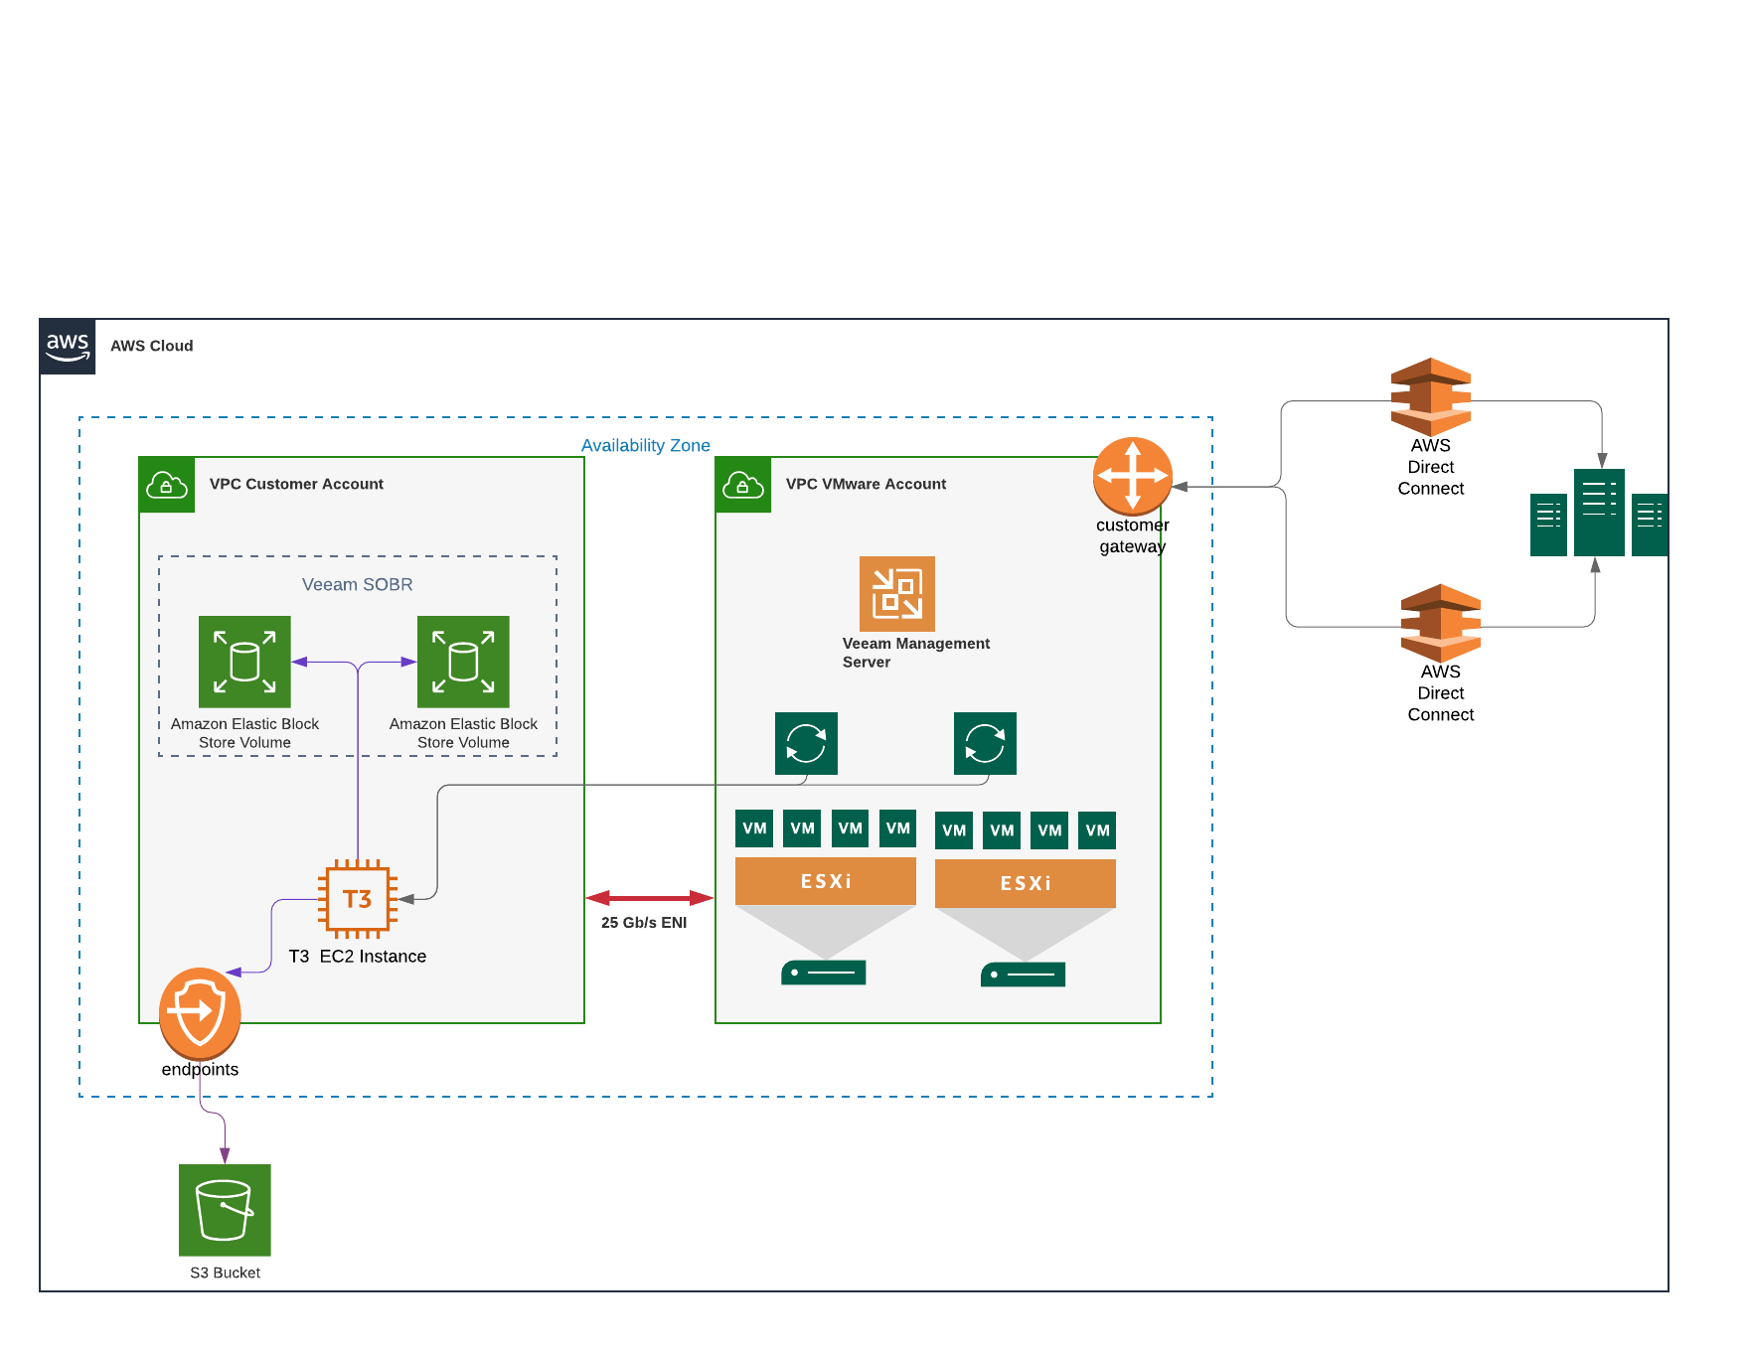
VMware Cloud on AWS Backup Overview

Slide 10
Proxy Design
Proxy per VMC Esx host
DRS rule to keep them apart
Windows 2019
2xCPU 4GB of ram
Veeam HotAdd

Slide 11
Repository Design

Slide 12
Deepdive VMware Cloud on AWS Repo design
EC2 or VMC
Windows or Linux ?
Repo Filesystem ?
Steady state or burstable compute?
EBS Storage types and size ?
EBS Performance calculations EBS scales with size
Location restrictions?
Notes:
Available in locations you require ?
T.X family is a burstable general purpose resource alternative to M4 or M5 resource . Instance

Slide 13
Design Criteria
RPO
RTO
Backup Window
Change Rate
Compression/Dedupe
Encryption
Operating System
File System
Other functions Surebackup ETC ?
JOB Mode
Full Backup Size
Incremental Size
Working Space
Backup Growth
Repo location (same or different AZ)

Slide 14
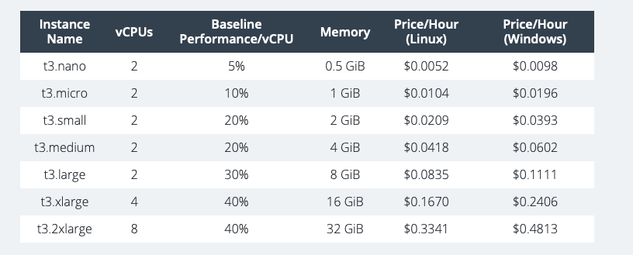
Choice of Instance Size & Family
RPO
RTO
Backup Window
Change Rate
Compression/Dedupe
Encryption
Operating System
File System
Other functions Surebackup ETC ?
Burst or Consistent ?

Slide 15
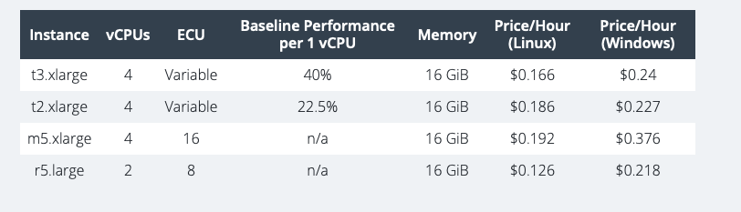
Choice of Instance Size & Family
RPO
RTO
Backup Window
Change Rate
Compression/Dedupe
Encryption
Operating System
File System
Other functions Surebackup ETC ?
Burst or Consistent ?

Slide 16
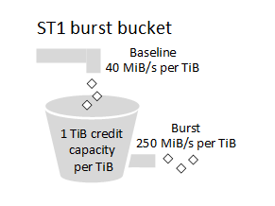
Choice of EBS Type
EBS Provisioned IOPS 64,000 IOPS 1000 MB/s Very expensive
EBS General Purpose 16,000 IOPS 250MB/s
Throughput Optimized 500 IOPS 500MB/s - Half the cost of EBS general purpose
Cold HDD 250 IOPS 250MB/s Cheapest

Slide 17
Instance Type | CPU | Memory (GB) | Network upto Gb/s | Price per Month $
T3.large | 2 | 8 | 5 | 81.11
M5.Large | 2 | 8 | 10 | 137.62
T3.xlarge | 4 | 16 | 5 | 175.68
M5.xlarge | 4 | 16 | 10 | 275.24
T3.xlarge 36% Cost saving over the M5

Slide 18
EC2 – Final Specification
t3.xlarge – Windows 2019 with up to 2x 16TB ST1 volumes
REFS formatted volumes

Slide 19
Secondary/Archive Storage

Slide 20
Secondary storage considerations
EC2 with EBS
Amazon S3
Amazon VTL
On premises ?
Notes:
Available in locations you require ?
T.X family is a burstable general purpose resource alternative to M4 or M5 resource . Instance

Slide 21
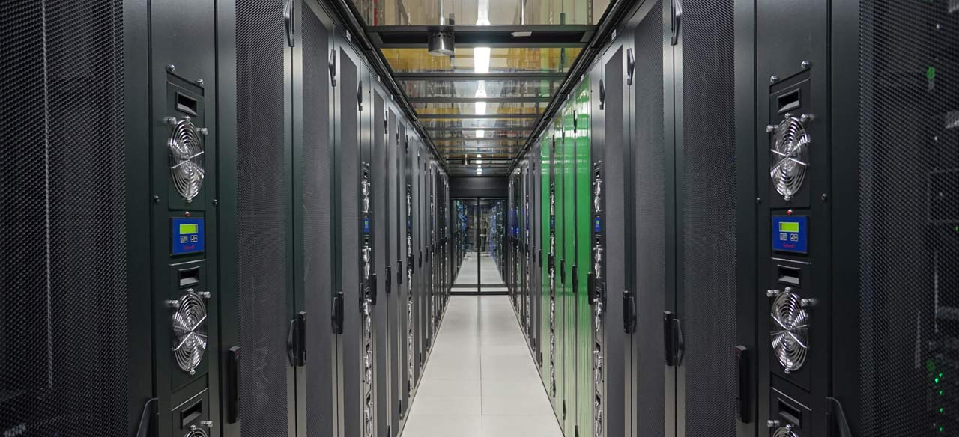
Secondary storage considerations
EC2 with EBS
Amazon S3
Amazon VTL
On premises ?
Notes:
Available in locations you require ?
T.X family is a burstable general purpose resource alternative to M4 or M5 resource . Instance

Slide 22
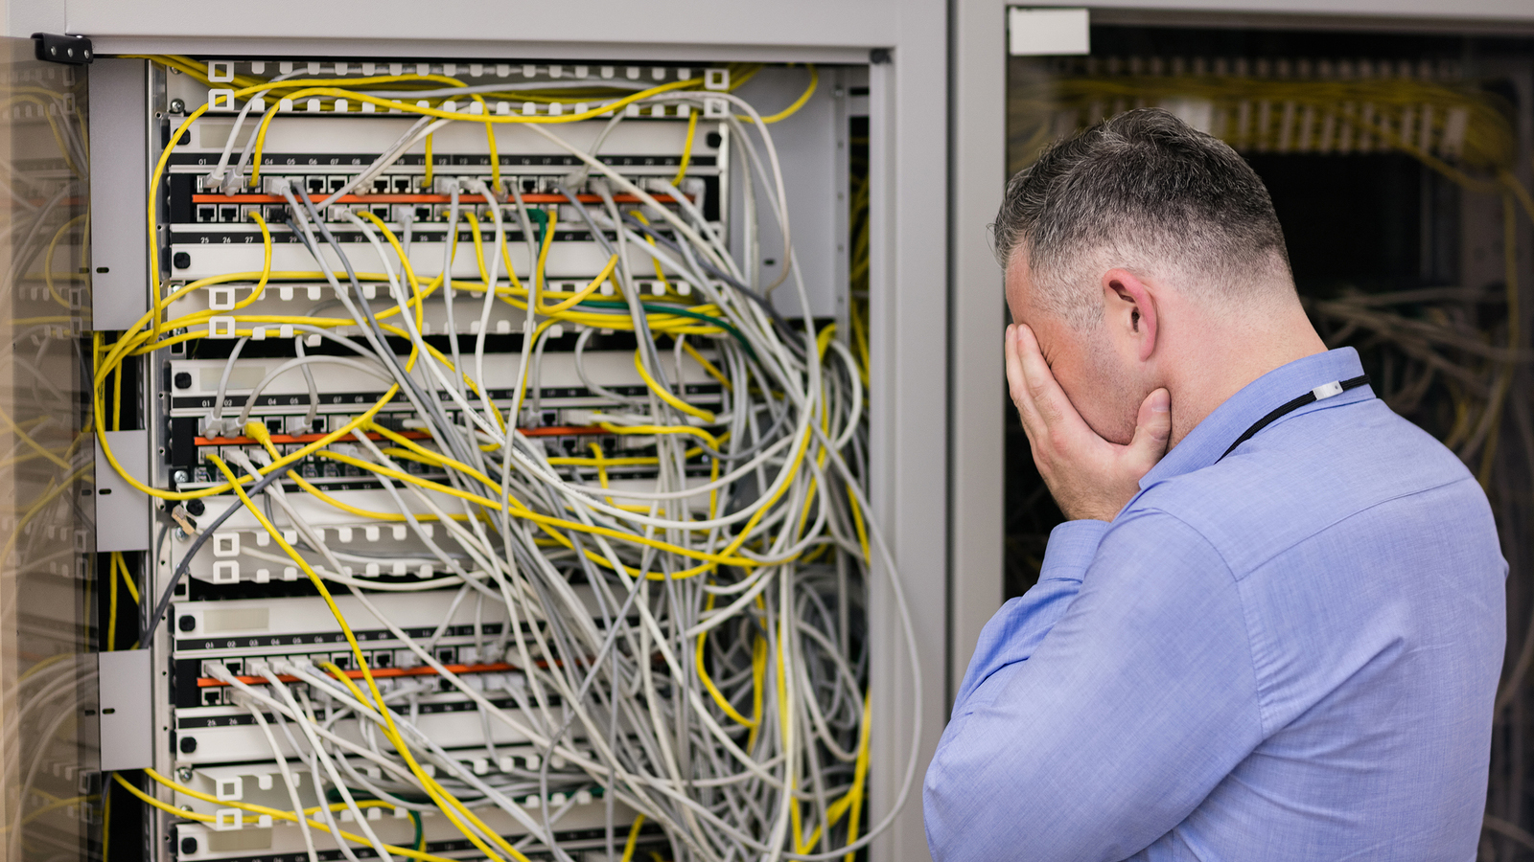
Secondary storage considerations
EC2 with EBS
Amazon S3
Amazon VTL
On premises ?
Notes:
Available in locations you require ?
T.X family is a burstable general purpose resource alternative to M4 or M5 resource . Instance

Slide 23
AWS S3
Incredible durability
Infinite scalability
Low latency & High throughput
Multi AZ
No Servers to maintain
Notes:
If it was 9.5 would have stuck with another EC2 instance in a different AZ

Slide 24
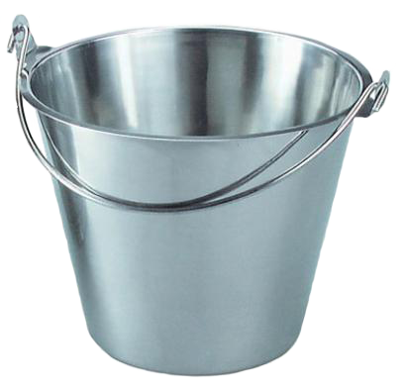
S3 Standard
S3 Intelligent Tiering
S3 Standard -IA
S3 One Zone-IA
S3 Glacier

Slide 25
Amazon Web Services S3
Long Term retention + Offsite
S3 – Standard (early delete is an issue with some of the other types)
Be aware of S3 API costs
Notes:
Clearly an existing AWS Customer ( required for VMware Cloud on AWS )
Awesome reliability statistics. Md5 checksum built in
Different set of credentials to access ( Some protection against ransomeware)
Restores from Archive will be slower. And incurr cost. No restore no cost….

Slide 26
Network Design

Slide 27
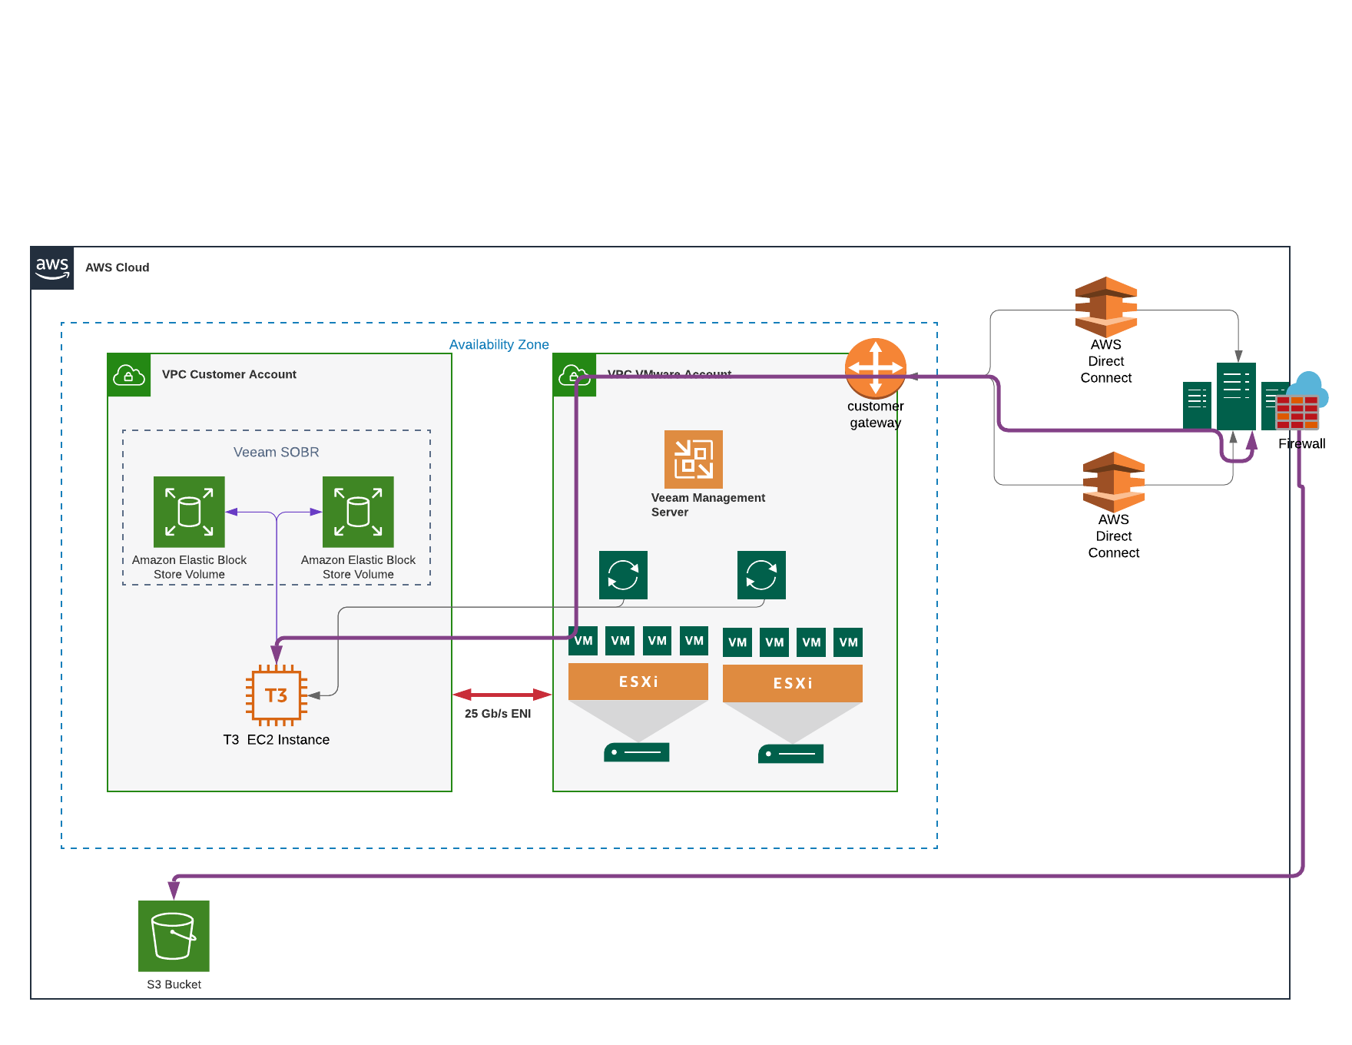

Slide 29
Other things to consider
Access to AWS Account – Securing this is critical
Billing Control – Billing Alerts,
Setup Monitoring of EC2 Servers
Scaling out
Security groups
Savings Plans

Slide 30
Thank you
@jameskilbynet

